Slide 1
Chapter 6: Soils, Natural Vegetation and Wildlife Resources of Ethiopia and the Horn
Presentation outline
Introduction
Ethiopian Soils: formation, Types, Degradation and Conservation
Soil formation
Major Soil Types in Ethiopia
Soil Degradation
Soil Erosion Control Measures
Natural Vegetation of Ethiopia
Introduction
Major Natural Vegetation Types
Natural vegetation Degradation
Natural Vegetation Conservation
Wild Life/wild animals in Ethiopia
Introduction
Wildlife Conservation
Challenges of wildlife conservation in Ethiopia

Slide 2
Soil Formation and Weathering
Soil formation is a long-term process.
The formation of a particular type of soil depends on parent material, climate, topography, living organism and time.
Weathering disintegrates the inorganic substances (rocks) of soils.
It is the breakdown of rocks at the Earth's surface, by the action of rainwater, extremes of temperature, and biological activity.
There are three types of weathering involving in soil formation.
Mechanical (physical) weathering
Biological weathering
Chemical weathering
Soils have two basic properties:
Physical Properties and
Chemical Properties

Slide 3
Major Soil Types in Ethiopia
Soils of Ethiopia are basically derived from crystalline, volcanic and Mesozoic sedimentary rocks.
FAO has identified 18 soil associations in Ethiopia at scale of 1:2,000,000.
Out of the major soils, 11 soil associations cover about 87.4 percent of the land area.
The six major groups of soils in Ethiopia are discussed under the following points:
A. Environmental condition i.e. parent material, climatic conditions, topography, the way they were formed.
B. Characteristic i.e. significant chemical and physical properties.
C. Agricultural suitability in relation to texture, structure, topography, moisture-storage capacity, etc.
D. Occurrence: general location of the soil types.

Slide 4
1.Nitosols and Acrisols
Nitosols
Nitosols develop on gently sloping ground.
Their parent materials include trap series volcanics, volcanic ash, and even metamorphic rocks.
They are strongly weathered soils but far more productive than most other tropical soils.
They are basically associated with highlands with high rainfall and they were, probably, formed on forest covered areas originally.
Due to the high rainfall, there is considerable soil leaching which makes the nitosols to be poor in soluble minerals like potassium, calcium etc.; and rich in non-soluble minerals like iron and aluminum.

Slide 5
The reddish-brown color of these soils is because of high concentration of iron (ferric) oxides due to leaching.
But they are now widely found on cultivated areas and on mountain grasslands.
Nitosols are dominantly found in western highlands (Wellega), southwestern highlands (Kaffa, Illuababora), Southern highlands, Central highlands, and Eastern highlands.
Acrisols
Acrisols are one of the most inherently infertile soils of the tropics, becoming degraded chemically and organically very quickly when utilized.
Acrisols have very low resilience to degradation and moderate sensitivity to yield decline.
In Ethiopia, it has lost most of the base nutrients and are characterized by low productive capacity.
Acrisols are found along with nitosols mostly in some pockets of southwestern highlands of Ethiopia where there is high rainfall.

Slide 6
2. Vertisols
Vertisols are heavy clay soils with a high proportion of swelling clays when wet, and cracks when dry.
These soils are extremely difficult to manage (hence easily degraded), but has very high natural chemical fertility.
Vertisols mostly develop on volcanic plateau basalt, trachyte and pyroclastic materials, sedimentary rocks, colluvial slopes and alluvial plains.
The vertisols are also soils of highlands and moderate climates.
In Ethiopia, they are commonly found in parts of Northwestern, Central and Southeastern highlands (especially in Gojjam, Shewa, Arsi, Bale and central Hararghe).

Slide 7
3. Lithosols, Cambisols and Regosols
These soils are mostly found in rugged topography and steep slopes.
There is little evidence of pedogenic processes (soil forming processes). As a result, they are young, shallow and coarse textured and so have low water holding capacity.
In addition, they are found in areas of low rainfall. So, most of the areas covered by these soils have limited agricultural use.
They are, in most cases, left under the natural plant cover and used for grazing.
By and large, these soils are found in different parts of rugged and steep slopes of Central Highlands, on the Rift Valley Escarpments and highlands in of western Hararghe.
Regosols and Lithosols are also found in the Danakil and eastern Ogaden.

Slide 8
4.Xerosols, Yermosols and Solanchaks
These are soils of desert or dry steppe soils majorly available in arid and semiarid areas.
Though the degree may vary, desert soils are characterized by high salt content and low organic content, because of the scanty vegetation.
Generally speaking, these soils have poor humus content and nitrogen, but are rich in phosphorus and potash and can be very fertile if irrigated.
Xerosols are soils of the deserts, has low organic content. These soils are extremely subjected to wind erosion and concentration of soluble salts.
Yermosols are even drier and more problematic than Xerosols.
Solanchaks are saline soils which develop in areas of high evaporation and capillary action. Badly managed irrigation schemes may turn soils into solonchaks.

Slide 9
In Ethiopia, Xerosols are found in Ogaden and northeastern escarpments, whereas the Yermosols and Solonchaks cover the Ogaden and Afar plains. The Solonchaks are majorly located in salty plains of Afar.
5.Fluvisols
Fluvisols develop on flat or nearly flat ground, on recent alluvial deposits. These soils are associated with fluvial (river), marine (sea) and lacustine (lake) deposits.
These are soils formed due to deposition of eroded materials from highlands.
The deposition takes place in depressions, lower valleys and lowlands. Lower regions of rivers like Omo, Awash, Abay and the plains of Akobo and Baro Rivers are home for fluvivsols. Lakes region (main Ethiopian rift) is also characterized by fluvisols.

Slide 10
Fluvisols are highly variable, but much prized for intensive agriculture because:
they develop on flat ground, deposition sites,
they are associated with rivers and ground water, making them important for large-scale irrigation and
they are fertile and their fertility is always renewed as a result of deposition of new soil materials
6.Luvisols
Luvisols develop mainly in areas where pronounced wet and dry seasons occur in alternation. Where leaching is not very high, they are found in association with nitosols.
Luvisols have good chemical nutrients and they are among the best agricultural soils in the tropics. So, they are intensively cultivated.
However, when luvisols are found on steep slopes (stony) and on flat areas (waterlogged) they are avoided and left for grazing.

Slide 11
In Ethiopia, places with luvisols include Lake Tana area, parts of Northern, Central and Eastern Highlands and Southern lowlands.
Soil Degradation
Soil degradation is defined as a change in any or all of soil status resulting in a diminished capacity of the ecosystem to provide goods and services.
It could also be the deterioration of the physical, chemical and biological properties of soil.
It is a critical and growing global problem. It is a major concern for at least two reasons.
First, soil degradation undermines the productive capacity of an ecosystem.
Second, it affects global climate through alterations in water and energy balances and disruptions in cycles of carbon, nitrogen, sulfur, and other elements.

Slide 12
There are three major types of soil degradation. These are:
i. Physical Degradation: refers to the deterioration of the physical properties of soil. This includes:
Compaction: densification of soil is caused by the elimination or reduction of structural pores.
Soils prone to compaction are susceptible to accelerated runoff and erosion.
B. Soil erosion: is a three-phase process consisting of the detachment of individual soil particles, transportation and deposition.
The continuous strike of soil surface by rain droplets considerably weakness the soil and makes susceptible to erosion.
When sufficient amount of water accumulates, the soil will begin to move towards lower slope until the erosive agent loses its energy. Erosion of topsoil by wind and water exceeds soil formation at an alarming rate.

Slide 13
Obviously for countries like Ethiopia where agriculture plays the dominant role in the economy and livelihood of the people, the causes, consequences and possible ways of minimizing soil erosion require serious consideration.
In Ethiopia, an estimated average of 42 tons per hectare of soils is eroded annually.
ii. Biological Degradation
Reduction in soil organic matter content, decline in biomass carbon, and decrease in activity and diversity of soil fauna are ramifications of biological degradation.
Because of prevailing high soil and air temperatures, biological degradation of soil is more severe in the tropics than in the temperate zone.
It can also be caused by indiscriminate and excessive use of chemicals and soil pollutants.

Slide 14
iii. Chemical Degradation
Nutrient depletion is a major cause of chemical degradation.
In addition, excessive leaching of cations in soils with low-activity clays causes a decline in soil pH and a reduction in base saturation.
Chemical degradation is also caused by the buildup of some toxic chemicals and an elemental imbalance that is injurious to plant growth.
Causes of soil degradation
Soil degradation may result from natural and human-induced causes.
Topographic and climatic factors such as steep slopes, frequent floods and tornadoes, storms and high-velocity wind, high-intensity rains and drought in dry regions are among the natural causes.

Slide 15
Deforestation and overexploitation of vegetation, overgrazing, indiscriminate use of agrochemicals and lack of soil conservation practices, and over extraction of ground water are some anthropogenic causes of soil degradation.
Soil Erosion Control Measures
The aim of soil conservation is to reduce erosion to a level at which the maximum sustainable level of agricultural production, grazing or recreational activity can be obtained from an area of land without unacceptable environmental damage.
Since erosion is a natural process, it cannot be prevented. But it can be reduced to a maximum acceptable level or soil loss tolerance.
We have two major soil erosion control mechanisms. These are:

Slide 16
A. Biological Control measures
These types of soil erosion control mechanisms include vegetative strips, plantation, and reforestation.
Biological controls can prevent splash erosion, reduces the velocity of surface runoff, increases surface roughness which reduces runoff and increases infiltration, and etc.
B. Physical control measures
Physical measures are used to control the movement of water and wind over the soil surface.
The major types of physical erosion control measures commonly applied in Ethiopia includes terracing, check dams, gabion, trenches, contour ploughing, soil bunds etc.

Slide 17
Natural Vegetation of Ethiopia
Major Natural Vegetation Types of Ethiopia
Taking altitude into consideration it is possible to broadly classify the vegetation belts of Ethiopia into the following five groups.
1.Afro-alpine and sub-afro alpine Region
2.Forest Region
3.Woodland Savannah Region
4.Steppe Region
5.Semi-desert Region
1.Afro-alpine and sub-afro alpine Region
Ethiopia has the largest extent of Afro-alpine and sub afro-alpine habitats in Africa.
This vegetation type, also known as high mountain vegetation is similar to the Alpine vegetation in temperate regions.

Slide 18
These ecosystems are found on mountains having an elevation ranging between 3,200 and 4,620 meters above sea level.
The Afro-alpine habitat covers nearly 1.3% of the total landmass of Ethiopia.
The Afro-alpine region is found at very high altitudes (4,000 – 4,620 m). Like any other landform in Ethiopian, the climate of Afro-alpine ecosystems is controlled by latitude and altitude.
The annul precipitation which ranges between 800 and 1,500 mm, is mostly in the form of sleet or snow.
Temperature records of 0ºC and below are widely experienced in these ecosystems.
Soils in this ecosystem are mostly shallow and eroded. The Bale and Semein mountains are typical examples of afro-alpine vegetations.

Slide 19
Compared to the Afro-alpine, the Sub-afro-alpine region is found at a lower elevation, roughly between 3,300 and 4,000 meters.
As a result, the plants in this region are adapted to somewhat less extreme environment than the Afro-alpine.
Vegetation in the Afro-alpine region consists of tussock grasslands, scrub, scattered mosses and lichens while the Sub-afro alpine region is dominated by woodland, often degraded to scrub stages and also wet grasslands.
Lobelia rhynchopetalum (giberra) and Erica arborea (Asta) are some of the dominant species in the Afro-alpineand Sub-afro alpine regions respectively.

Slide 20
2. Forest Region
Forest is a complex ecosystem consisting predominantly of trees that shield earth and support numerous life forms.
Not all forests are similar in terms of species composition, structure and physiognomy.
In any geographical region, environmental factors such as climate, soil types, topography and elevation determine the types of forests.
In Ethiopia, forests are found at different elevations, 450 to 3,500m in humid parts and 2,300 to 3,300 m in most arid parts.
Moreover, forests are characterized by variation in mean annual rainfall that range between 200 and 2,200mm. These wide variations in rainfall and altitude result in two broad classification of forests:
Highlands and Lowland forests. Highland forests include Hagenia Abyssinia (Kosso), Juniper procera (tid), Arundinaria Alpina(kerkha), Podocarpus falcatus (zigba), Aningeria adolfi friedericii (keraro) and Olea africana (Weyra) forests; while Baphia are classified as lowland forests

Slide 21
Moreover, there are also Gallery (Riverine) Forests.
Gallery (Riverine) Forests are forests that stretch along the banks of the lower courses of rivers.
Riverine forests are classified as lowland forests and are found in some places such as the banks of Awash, Wabishebelle, Ghenale etc.
Dominant species include Ficus sur (sholla) and different kinds of acacia trees.
3. Woodland Savannah Region
Like the forests, the woodland savannahs are also found in areas of wide altitudinal ranges (250 to 2,300 m).
Although the mean annual rainfall ranges between 200 and 1,400 mm, the large part of this region is found at a lower elevation and in a drier environment.

Slide 22
The plants in the woodland savannah are known for their xeromorphic characteristics like shading of leaves during the dry season.
Vegetation types with intermediate characteristics between savannahs and woodlands are shrublands and bushlands.
Woodland savannah region can be broadly classified into three divisions:
Juniper procera (tid) is dominant species for both the Junipers Forests and Junipers Woodlands. The difference is in height: 3 - 45 meters tall in the forests and 10 -15 meters in the woodlands.
Acacia woodlands are dominated by both trees and shrubs, which belong to the same genus 'Acacia'. E.g. Acacia etbaica(grar),Acacia mellifera (Konter).
Mixed deciduous woodlands: As the name implies, most of the trees in mixed deciduous woodlands shed their leaves during the dry season.

Slide 23
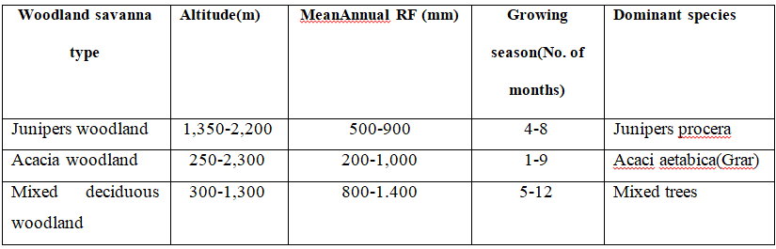
Table 6.1: Woodland Savanna Region
4. Steppe and Semi Desert Regions
These are regions in the arid and semiarid parts of the country where the temperature is very high and the rainfall very low.
Both are found at low elevations, the steppe at elevations of 100 to 1,400 m above sea level and the semi-deserts at 130 meters below sea level to 600 meters above sea level.

Slide 24
The steppe gets a mean annual rainfall of 100 to 550 mm as compared to 50 to 300 mm for the semi desert areas.
Growing period lasts up to 2 months for the steppe and a maximum of one month for the semi-deserts.
Even though there is a variation in the degree of alkalinity and salinity; soils in both regions are generally alkaline and saline.
In these regions xerophytic (i.e. drought-resisting plants) are the dominant vegetations.
Xerophytic plants such as short shrubs, scattered tufts of grass species and a variety of acacias are some of the examples.
Where there are moist soils, rich vegetation of acacia and palm trees may be observed. Trees are normally restricted to fringes along watercourses.

Slide 25
Natural vegetation Degradation
A century ago, forests covered about 40 percent of the total land area.
For the last few decades, forests have been cleared for different reasons.
Major causes for the gradual disappearance of the natural vegetation in Ethiopia are:
Clearing of forests for cultivation
Timber exploitation practices
Charcoal burning and cutting for fuel
Extensions of coffee and tea production areas
Overgrazing
Expansion of settlements both rural and urban, and
clearing for construction.

Slide 26
6.2.3. Natural Vegetation Conservation
Conservation of biodiversity is protection and management of biodiversity so as to maintain at least its current status and derive sustainable benefits for the present and future generation.
There are three main approaches of biodiversity conservation:
Protection: through designation and management of some form of protected area. Protected areas include sanctuaries, national parks, and community conservation areas.
Sustainable forest management: involving sustainable harvesting of forest products to provide a source of financial income
Restoration or rehabilitation: is the process of assisting the recovery of a forest ecosystem that has been degraded, damaged, or destroyed. This may involve the re-establishment of the characteristics of a forest ecosystem, such as composition, structure, and function, which were prevalent before its degradation.

Slide 27
6.3. Wild Life/wild animals in Ethiopia
Generally speaking, the main wild life concentrations in the country occur in the southern and western parts.
The wild animals in Ethiopia can be classified into five major groups:
1. Common wild animals (those animals that are found in many parts of the country (e.g. hyenas, jackals)
2. Game (lowland) animal, (which include many herbivores like giraffes, wild asses, zebras etc. and carnivores like lions, leopards, and cheetahs)
3. Tree animals or arboreals (which include monkeys, baboons)
4. A variety of birds in the Rift Valley lakes
5. Rare animals (gelada baboon and Semien fox) scattered in highlands; walia- ibex in the Semien Massifs, Nyala in the Arsi Bale massifs).

Slide 28
6.3.1. Wildlife Conservation
Wild animals can be used for:
scientific and educational researches (valuable information for medical purposes and environmental studies)
physical and mental recreation (aesthetic value)
promotion of tourism (economic value)
its potential for domestication
maintaining ecological balance
To prevent the destruction of wildlife a total area of nearly 100,000 square kilometers of national parks, sanctuaries, community conservation areas, botanical gardens, wildlife reserves etc. have been established in different part of the country. Hence in Ethiopia there

Slide 29
21 major national parks,
2 major wildlife sanctuaries,
3 wildlife reserves,
6 community conservation areas,
2 wildlife rescue centres,
22 controlled hunting areas,
2 botanical gardens, and 3 biosphere reserves
Even though the number and the predominant animals may vary, many of the national parks in Ethiopia have different turnovers of animals.
These include buffaloes, zebras, lions, elephants, ostriches, giraffes, oryx, African wild asses, etc.

Slide 30
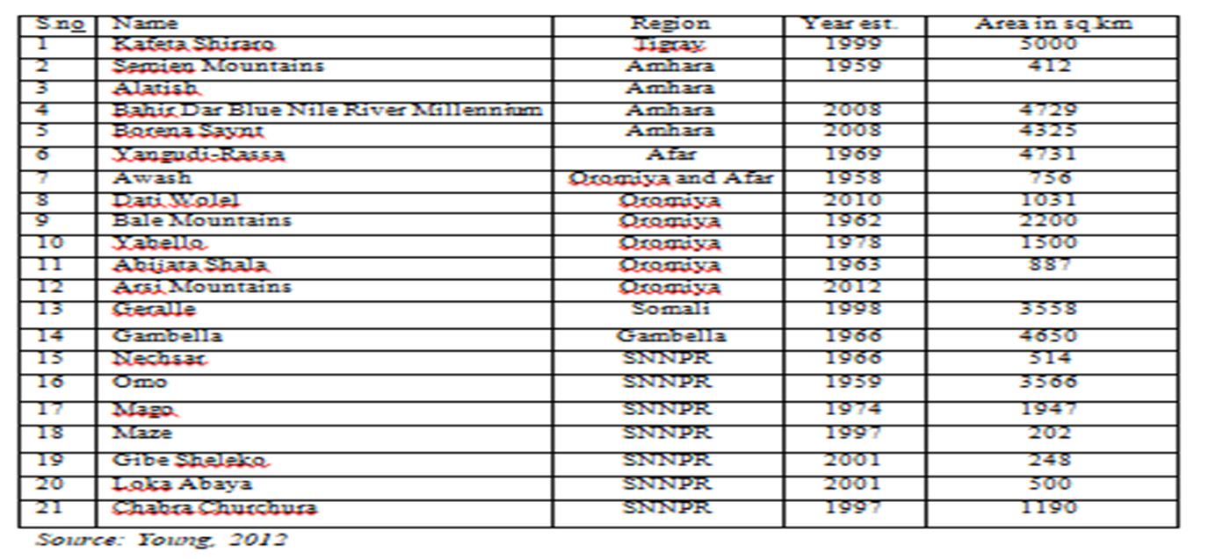
Table 6.2: National Parks of Ethiopia

Slide 31
Cont.,
Some of the national parks are unique in their wild animals they have. E.g.
1. Abiyatta-Shalla lakes National Park is predominantly bird sanctuary. Important bird species include the flamingos and pelicans.
2. Omo, Mago, and Gambela National Parks have hippopotamus and crocodiles in rivers and lakes.
3. Semien and Bale Mountains National Parks have rare animals like Walia ibex, Semien fox, gelada baboon and Nyala.

Slide 32
Cont.,
6.3.2. Challenges of wildlife conservation in Ethiopia
Protected areas were created to protect the major biodiversity.
However, it is a sad fact that these ecologically fundamental resources are usually undervalued and are under threat from various dimensions.
Here are some of the major challenges that Ethiopian protected areas are facing;
Limited awareness on the importance of wild life
Expansion of human settlement in protected areas.
Conflict over resource
Overgrazing (fodder and wood)
Illegal wildlife trade
Excessive hunting
Tourism and recreational pressure
Mining and construction material extraction
Forest fire

Slide 33
Table 6.2: National Parks of Ethiopia
THANK YOU!

